Slide 1
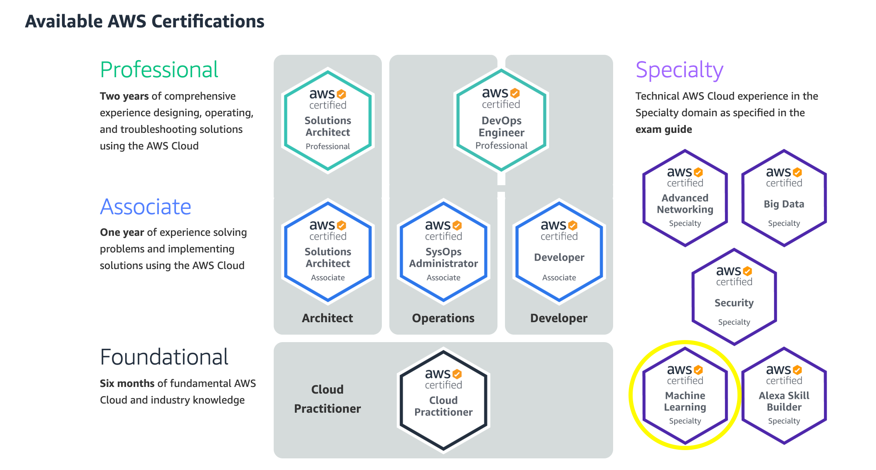

AWS Machine Learning Specialty Certification Exam
Welcome

Slide 2
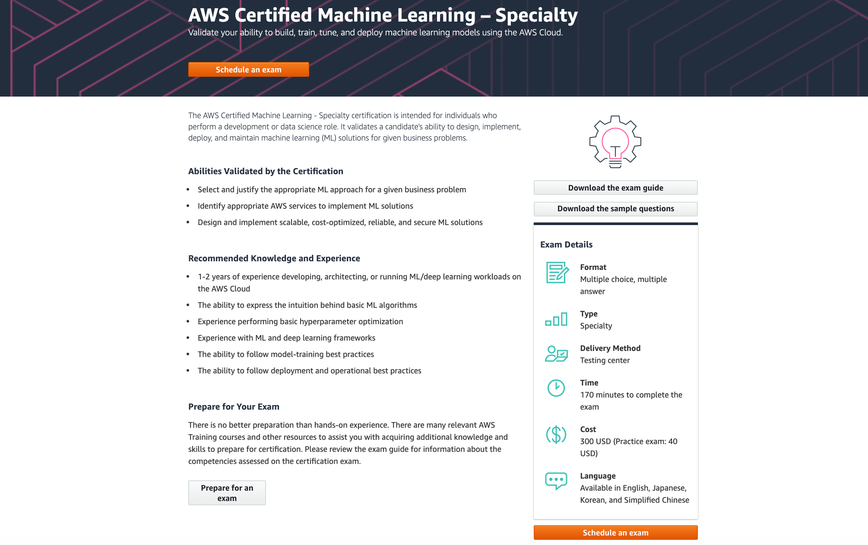
Recommended Prior Experience
Knowledge and Expertise

Slide 3
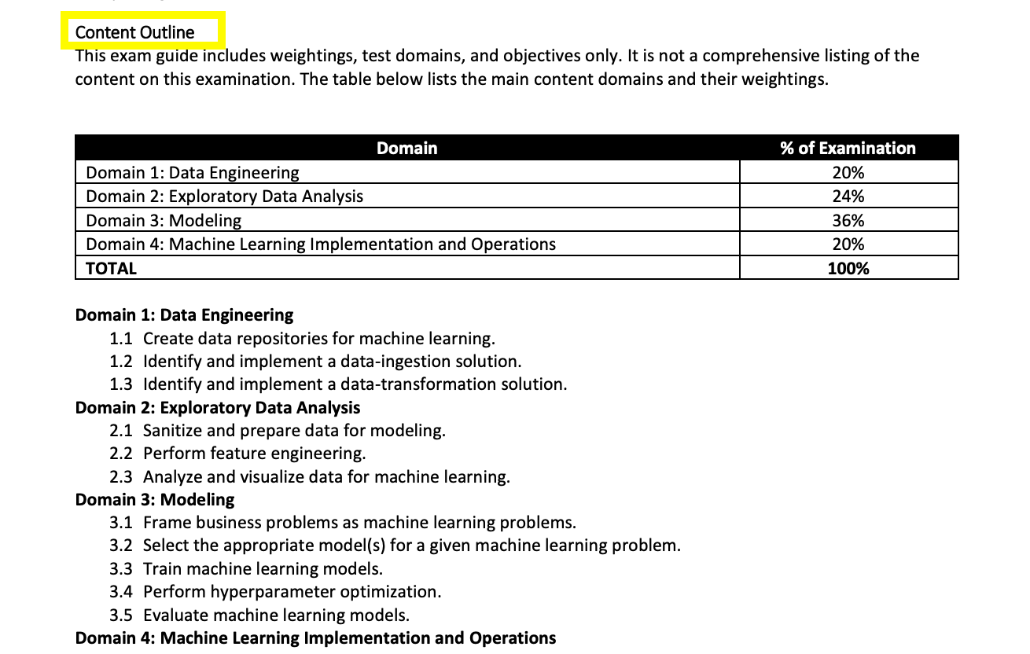

Machine Learning Exam Course Structure
High Level Sections

Slide 4



Machine Learning Services
Powerful Machine Learning Platform

Slide 5
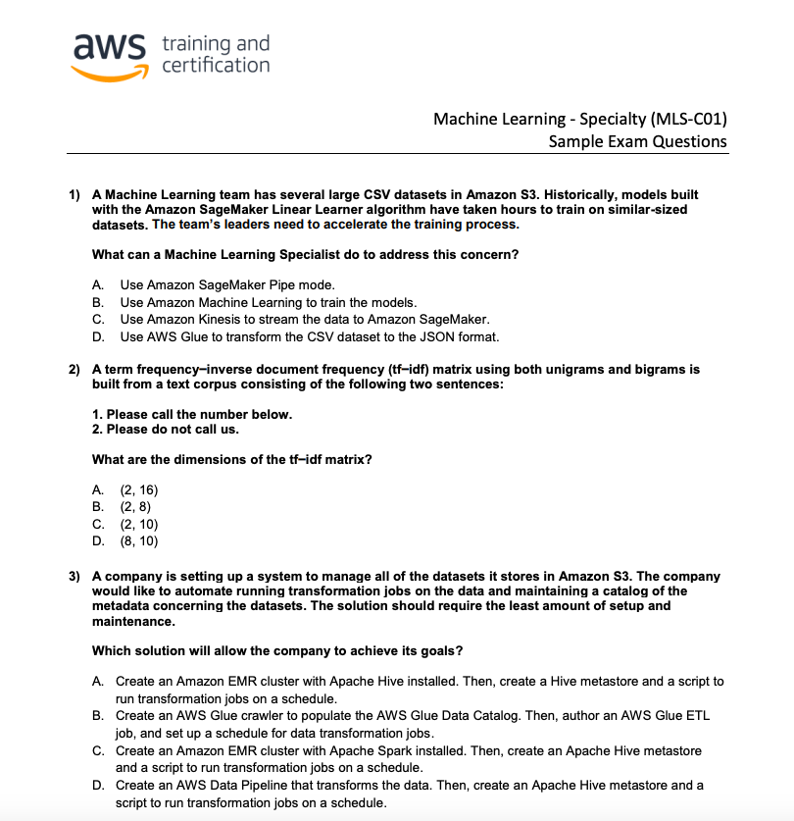
Machine Learning Exam
Take the Test with Confidence

Slide 6
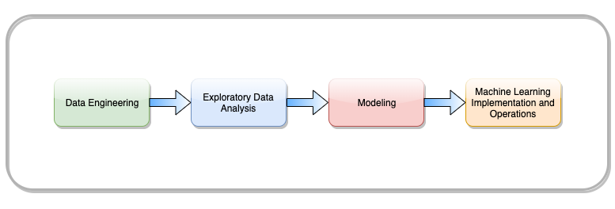
Machine Learning Exam Blueprint
All Sections Covered
Create data repositories for machine learning
Sanitize and prepare data for modeling
Frame business problems as machine learning problems
Build machine learning solutions for performance, availability, scalability, resiliency, and fault tolerance
Identify and implement data-ingestion and data-transformation solutions
Select the appropriate model(s) for a given machine learning problem
Recommend and implement the appropriate machine learning services and features for a given problem
Perform feature engineering
Analyze and visualize data for machine learning
Train machine learning models
Apply basic AWS security practices to machine learning solutions
Perform hyperparameter optimization
Evaluate machine learning models
Deploy and operationalize machine learning solutions

Slide 7
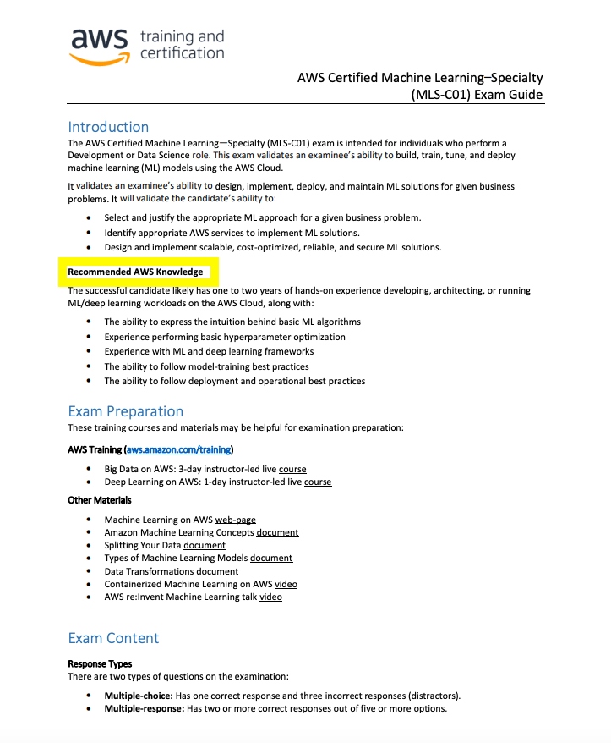
Assumed Machine Learning Knowledge
Recommended Knowledge

Slide 8
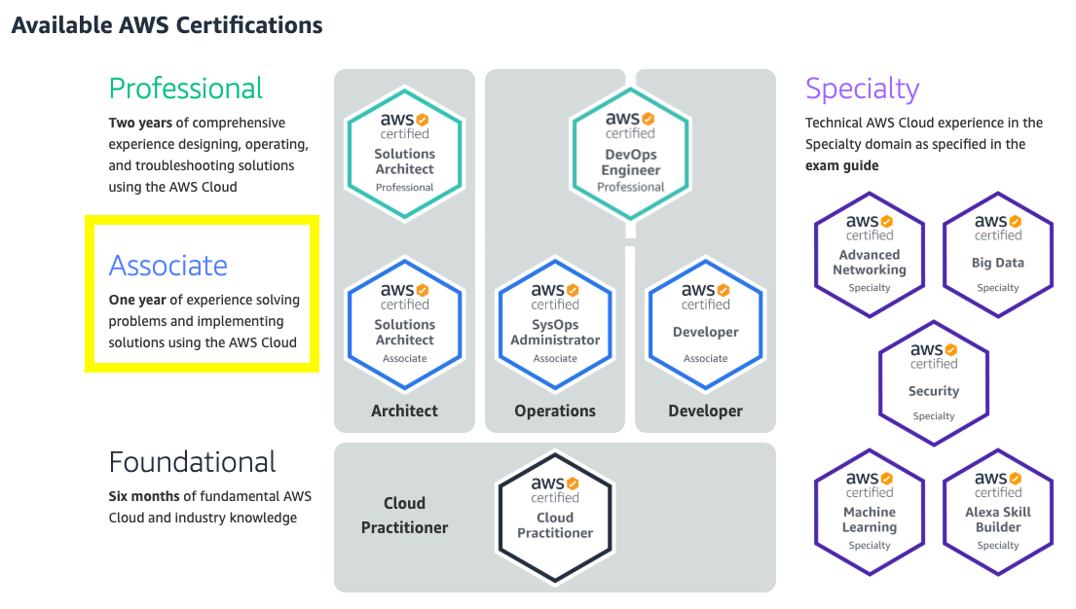
Assumed Machine Learning Knowledge
Hands-on Experience

Slide 9
Machine Learning Specialists in High Demand
CIO Magazine
Machine learning to remain most in-demand AI skill
Machine learning today is used for image identification and classification at scale, consumer-driven chatbots, NLP and voice search, lead prediction, and more advanced neural networks, like Google’s DeepMind network. The applications for and uses of machine learning are just now becoming realized, but employer demand for talent with ML skills has already risen dramatically.
Over the past three years alone the number of AI-related job postings on Indeed has increased by 119 percent, according to the platform’s latest AI talent report. The machine learning engineer role was cited as the third most in-demand AI job of the moment with machine learning ranked as the most in-demand AI skill. With AI projected to create 2.3 million jobs by 2020, according to a Gartner report, I think it’s safe to assume that machine learning will remain an in-demand skill for the foreseeable future.

Slide 10
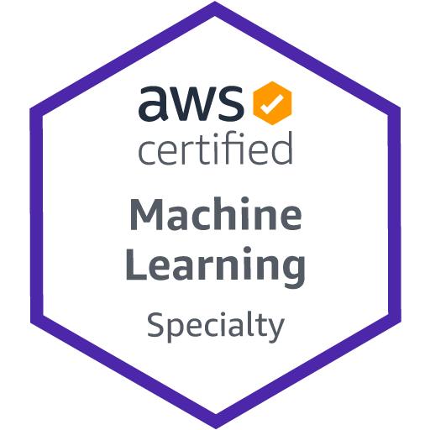
AWS Machine Learning Specialty Certification Exam
Crush It!

